Slide 1
Final projects: Computer Information Technology course
A DOCUMENT (CV)
A SPREADSHEET (ANALYSIS)

Slide 2
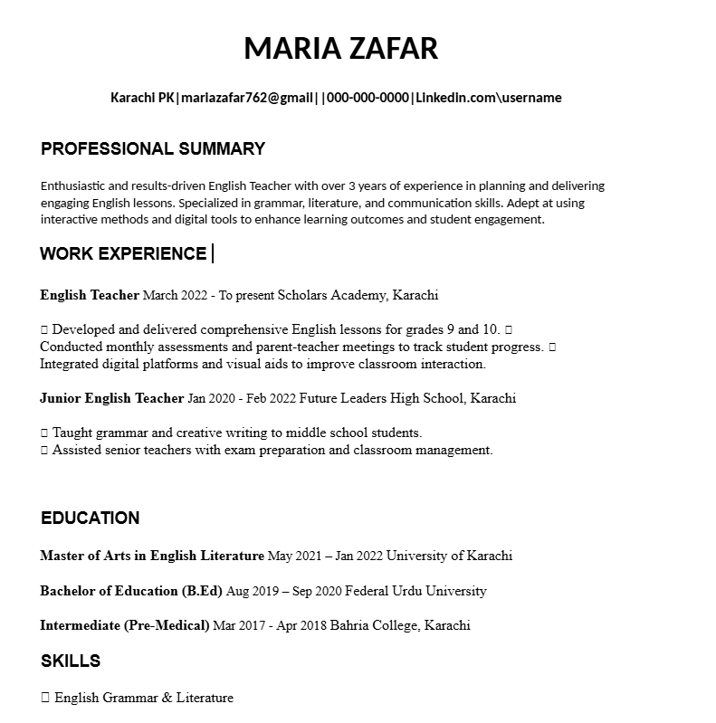
A Sample Resume
My Resume consist of five sections which include my academic and professional details .

Slide 3
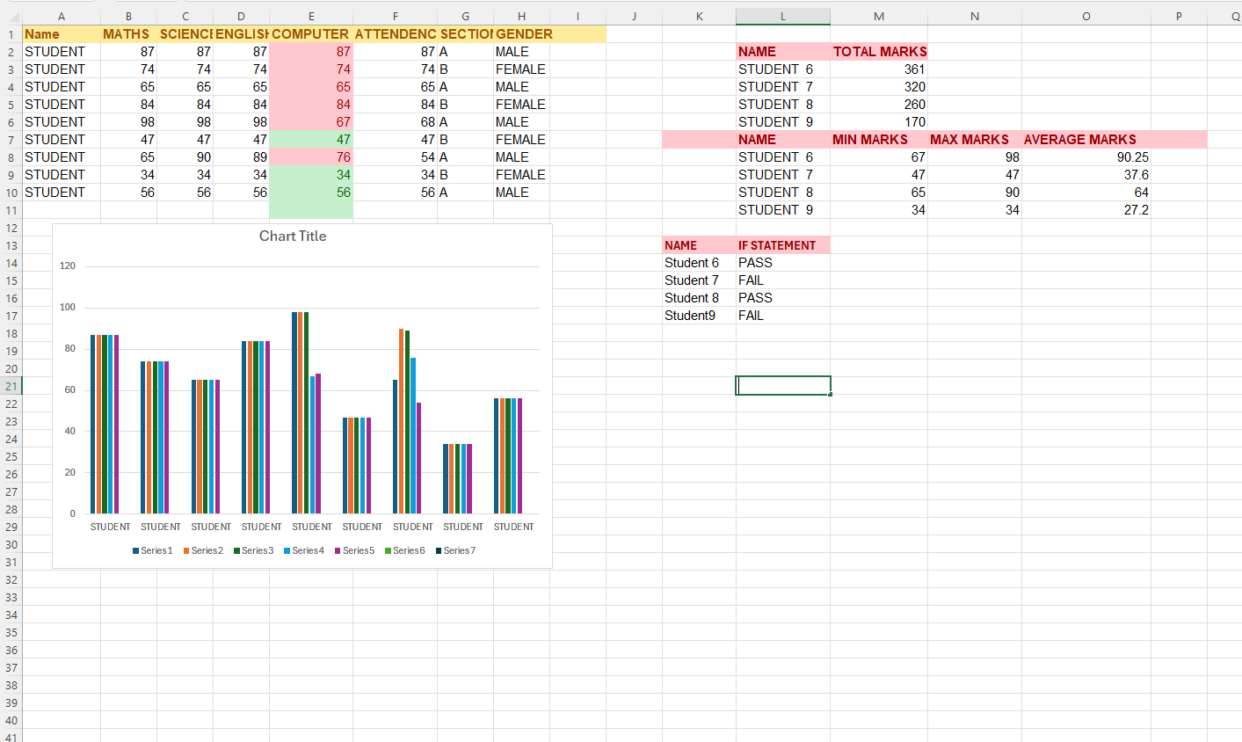
A spreadsheet analysis
Microsoft Excel is a powerful spreadsheet application developed by Microsoft that allows users to store, organize, and analyze data efficiently. It is widely used for data entry, financial analysis, budgeting, reporting, and much more. Excel is popular in businesses, schools, and personal use due to its flexibility and wide range of functions and features. One of Excel’s most powerful capabilities is the use of formulas and functions, which allow users to perform automatic calculations and complex data analysis.

Slide 4
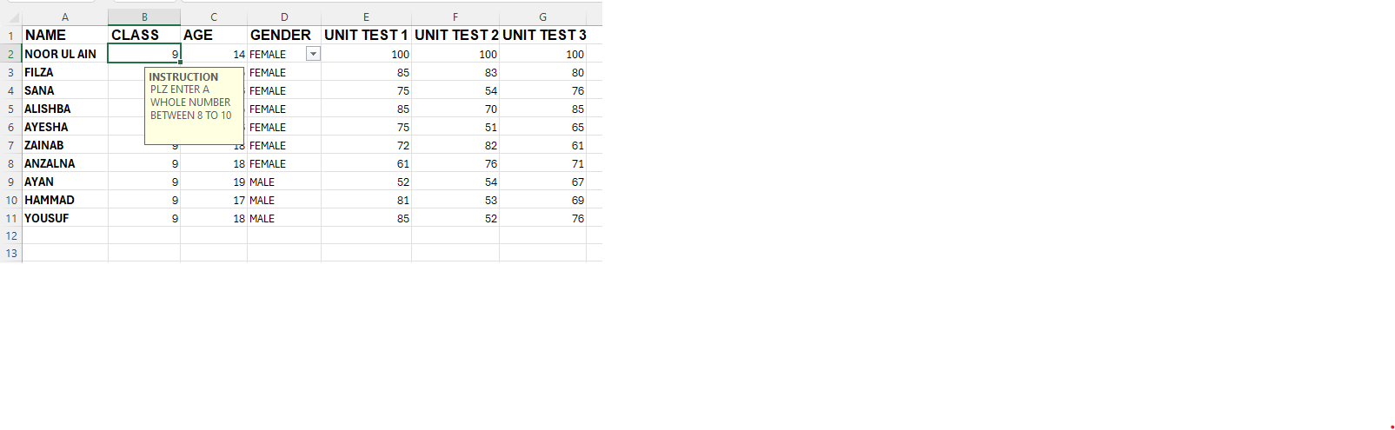
Data validation
Here I have a data validation and restricted to only enter a number between 1 to 10 and when he enter a number he gets an error.

Slide 5
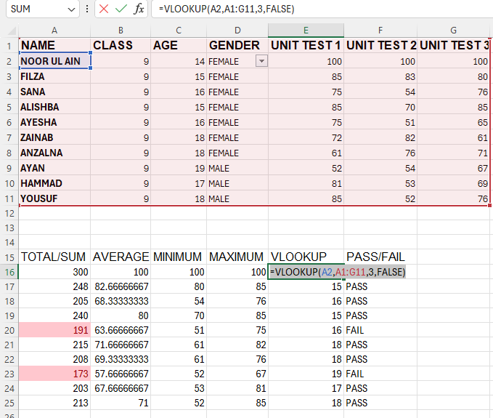
VLOOKUP IN EXCEL
VLOOKUP IN EXCEL IS USED TO LOOKUP A CERTAIN
VALUE IN ANY COLUMN

Slide 6
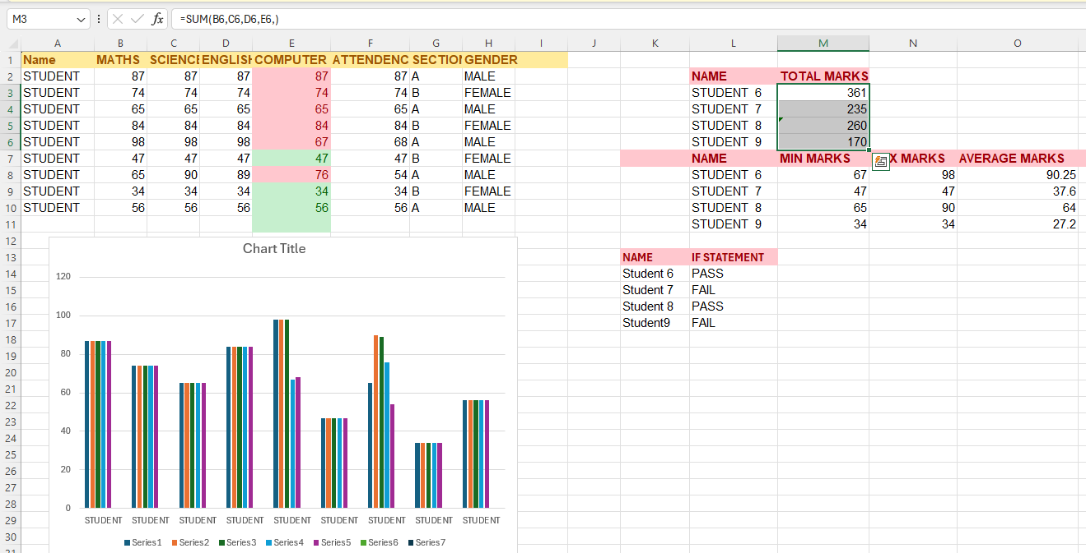
Sum in excel
SUM IS ADD THE NUMBERS

Slide 7
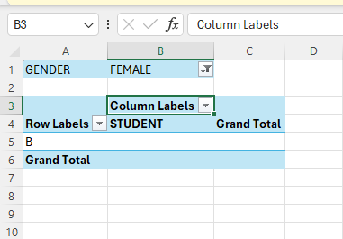
Pivot table in excel
I HAVE CREATED A PIVOT TABLE IN EXCEL TO SORT
AND FILTER MY DATA

Slide 8
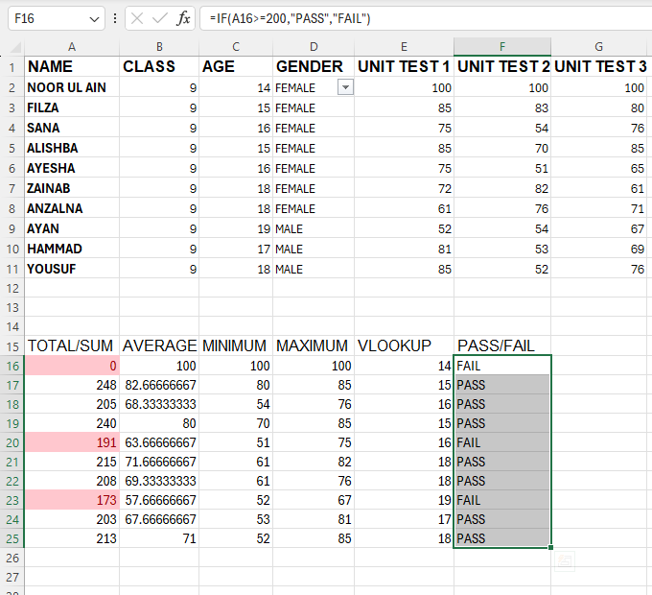
If statement in excel
USE IF FUNCTION IN EXCEL TO TEST CONDITIONS
AND RETURN DIFFERENT VALUES BASED ON TRUE
OR FALSE RESULTS

Slide 9
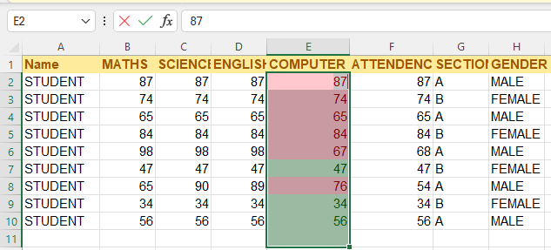
Conditional formatting in excel
USE CONDITIONAL FORMATTING IN EXCEL TO
HIGHLIGHTS THE CELLS BASED ON SPECIFIC
CONDITIONS SUCH AS VALUES, FORMULAS,
OR FORMATTING

Slide 10
Presented by:
CIT STUDENT.
MARIA ZAFAR

